Slide 1
Low-Cost, Portable Incubator
Joseph Urso, Jason Ye, Sindhuja Darisipudi, Michael Tang, Nora Han
Notes:
add hook, laying out problem
mention water testing
Say all names
add hook(?)

Slide 2
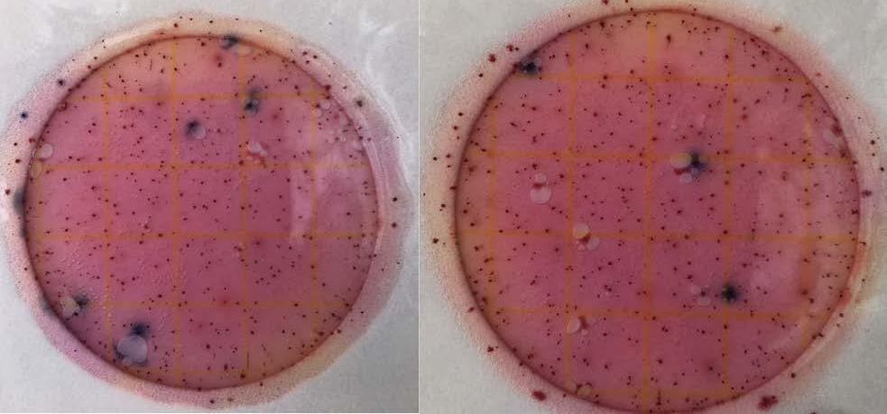
Need for Clean Water Testing in Low Resource Areas
Water sanitation crisis affects > 780 million people
Existing water quality tests require infrastructure to run
Public Invention designed a solution
Petrifilms need to be incubated for 24-48 hours at ≅ 35 °C
3M Petrifilms
Notes:
our client, public invention, designed etc.
explain what a petrifilm is
ppl have bad water -> want to test water -> client wants to fix this -> client is using petrifilms -> petrifilms need to be incubated at 35C for 24-48 hrs

Slide 3
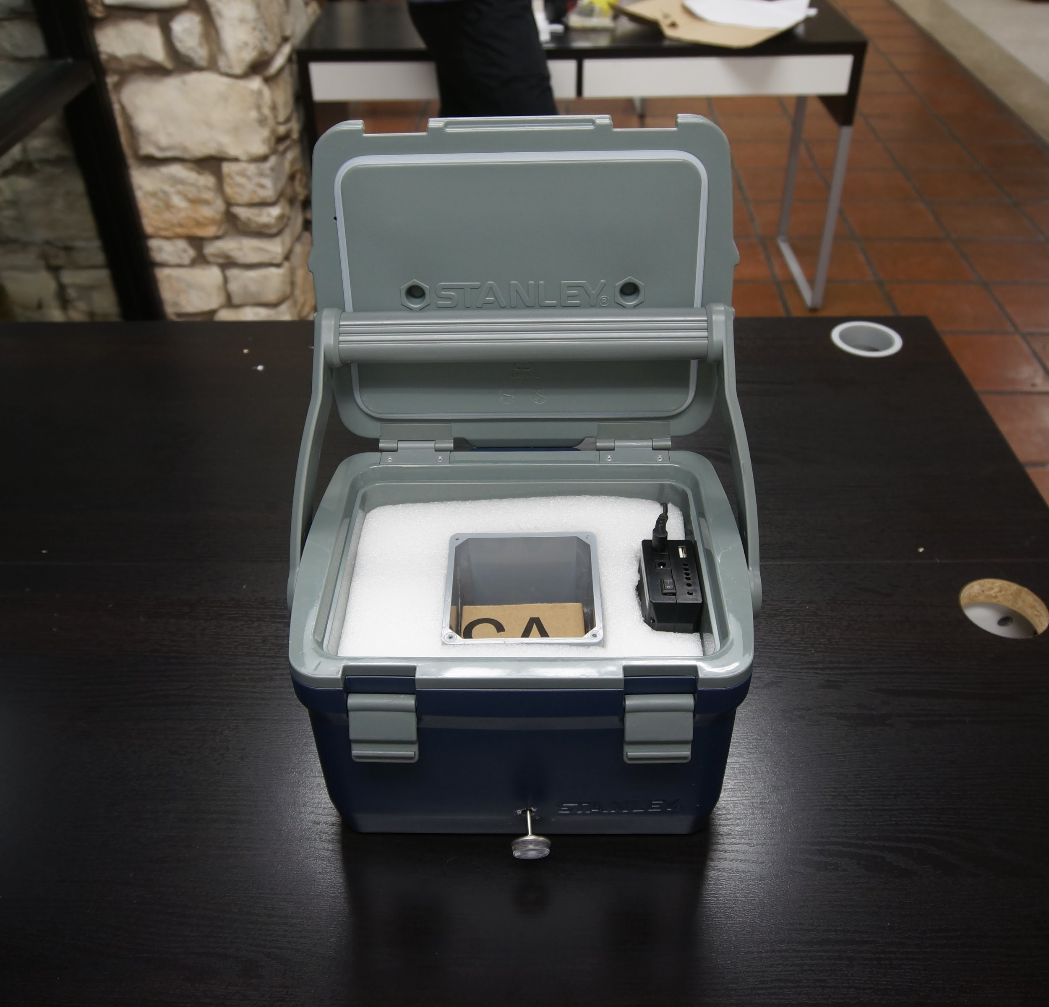
Existing Prototype: “The Armadillo”
Too large
Not easily portable
No data logging capabilities
Public Invention’s Incubator, “The Armadillo”
Notes:
not easily portable (mention size and weight)
no data logging capabilities — need to mention the fact that you are remote/rural, so resources of an actual lab are not that easy to come by

Slide 4
Design a low-cost portable, data-logging incubator for remote water sanitation testing in low resource areas.

Slide 5
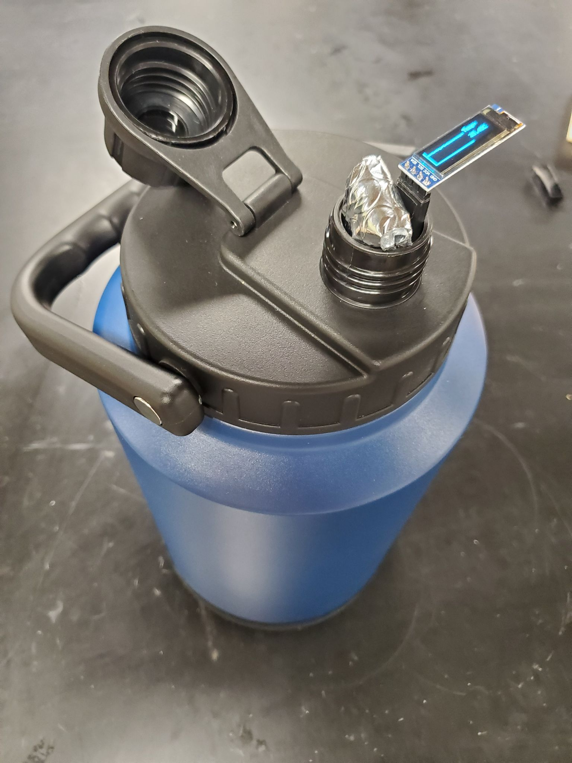
Final Solution
Thermos-based incubator
Control system using heating pads
Petrifilm shelf
Self-powered with battery pack
Final Portable Incubator
Notes:
Include a couple bullets on the side
Explain operations
Emphasize casing, control system, battery,

Slide 6
Design Constraints
Design Constraint | Target value
Temperature Fluctuation | Fluctuation between 34 °C and 36 °C for a 48 hour cycle
Safety | Full external waterproofing. No maintenance of electrical components needed for safety.
Notes:
Gray out the title boxes
Try to come up with numbers for safety

Slide 7
Design Objectives
Design Objective | Target Value
Cost | < $300
Size | < (31cm x 34cm x 22cm)
 | Mass < 10 kg
Ease of Fabrication | 100% of parts can be purchased online or at a local store.
 | Any user can operate with user manuals and pre-recorded videos ≥ 4 on user defined scale
Durability | Operate for ≥ 20 field trips without maintenance. IPX6+ waterproof ability.
Battery Duration | Should operate for ≥ 24 hours after one charge.
Notes:
Identify important objectives and talk about them most

Slide 8
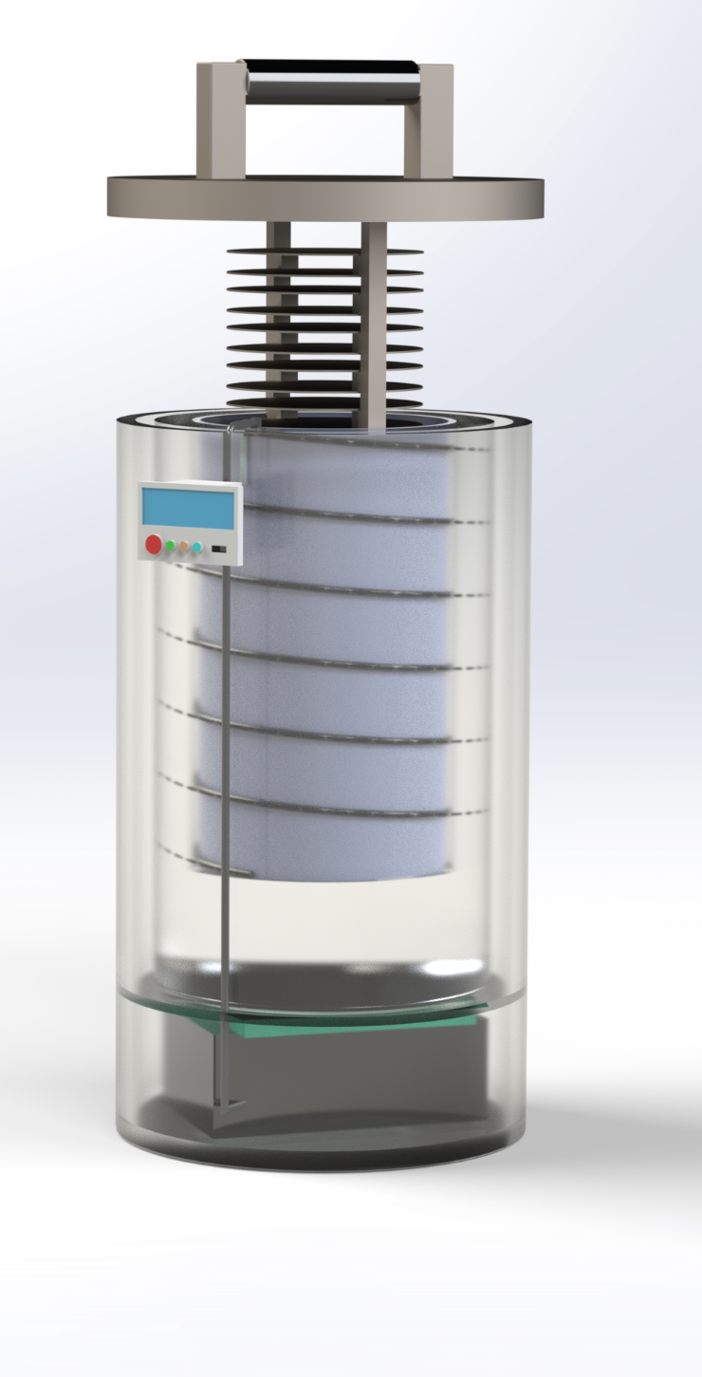
Conceptual Design: Incubator
Shelf
Cylindrical form factor
Control panel
Height=38cm
Control board (Arduino)
Battery
D=22cm

Slide 9
Conceptual Design: Control System
temp <34.5°C?
no
temp >35.5°C?
no
Start
yes
yes
start heating
stop heating
no change
Log temperature & Display on OLED Screen
no
temp >36°C or <34°C for over 3min
yes
Alarm
Notes:
NORA: LAST SLIDE

Slide 10
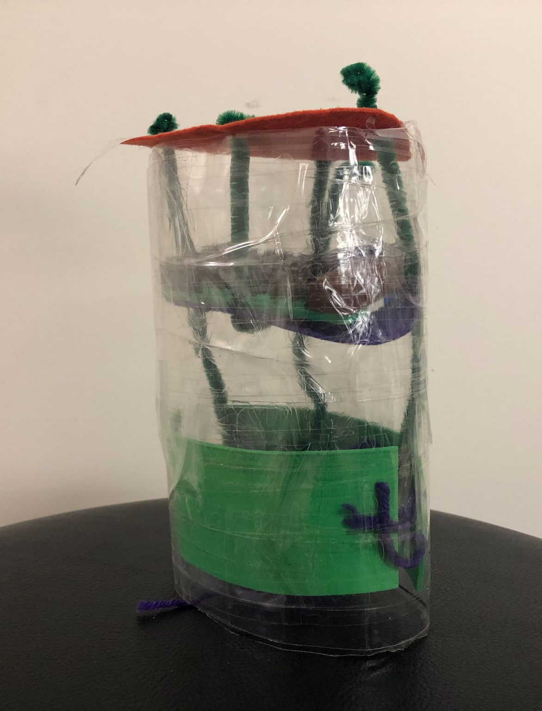
Low-Fidelity Prototype: Small Thermos
Observations:
Too Small
Heating Pads > Heating Tape
Stacking is not a realistic spatial configuration
Compartment 1: Electronics
Needs work:
Correct sized thermos
Correct spatial configuration
Compartment 2: Incubation Chamber
Side View of Small Thermos
Notes:
BEGIN: SINDHUJA

Slide 11
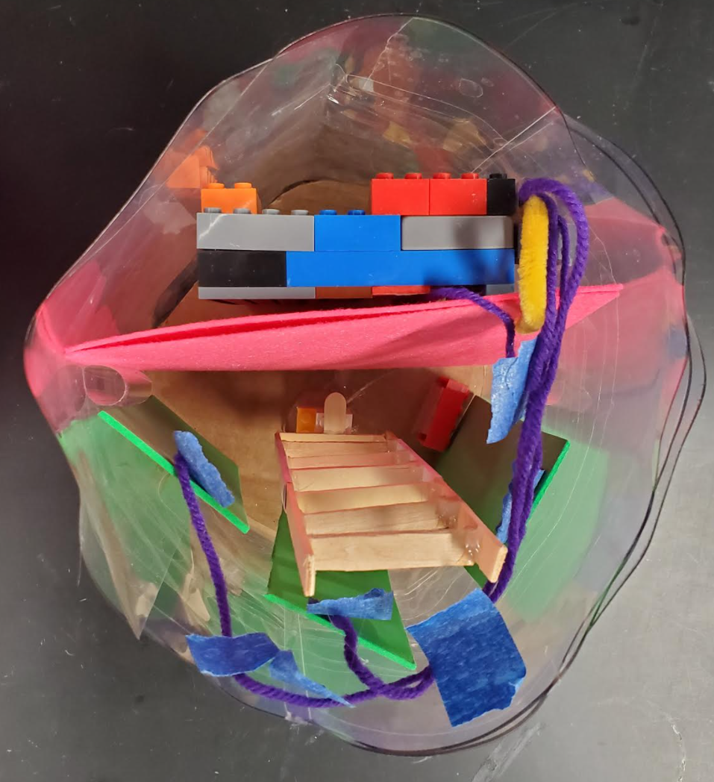
Low-Fidelity Prototype: Large Thermos
Observations:
Much better spatial organization
Tight fit if we need to change batteries
Compartment 1: Electronics
Foam Insulation as separation
Compartment 2: Incubation Chamber
Needs work:
Shelf Design
Overhead View
Notes:
Foam Insulation as Separation

Slide 12
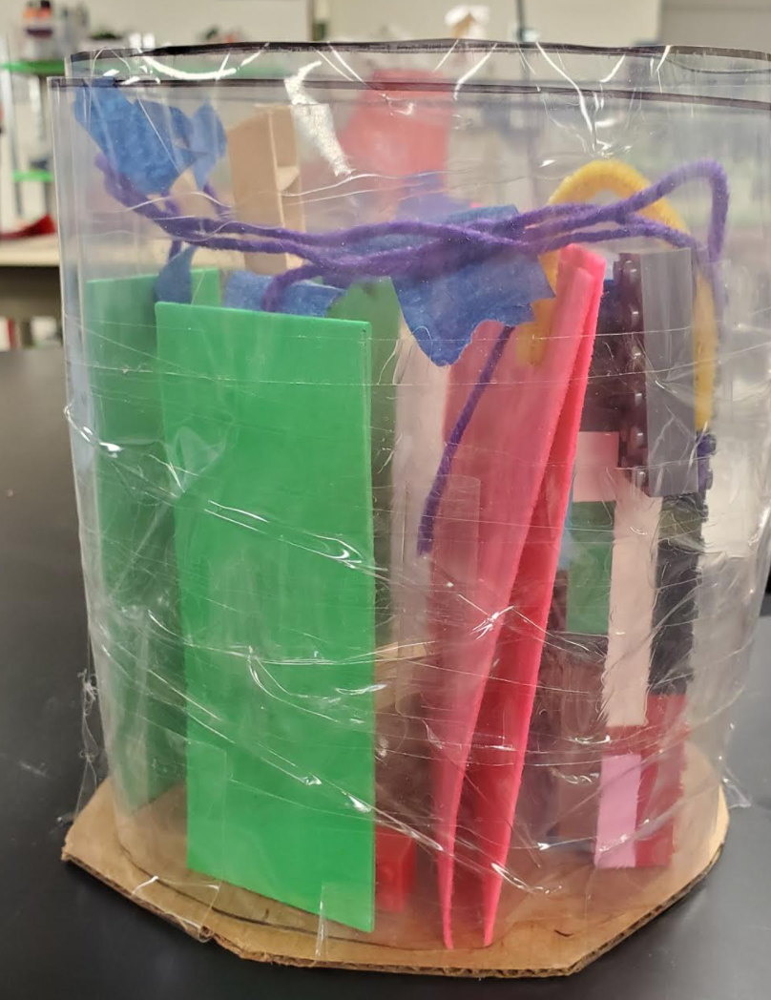
Low-Fidelity Prototype: Large Thermos
Observations:
Much better spatial organization
Tight fit if we need to change batteries
Compartment 1: Electronics
Foam Insulation as separation
Compartment 2: Incubation Chamber
Needs work:
Shelf Design
Side View
Notes:
Foam Insulation as Separation

Slide 13
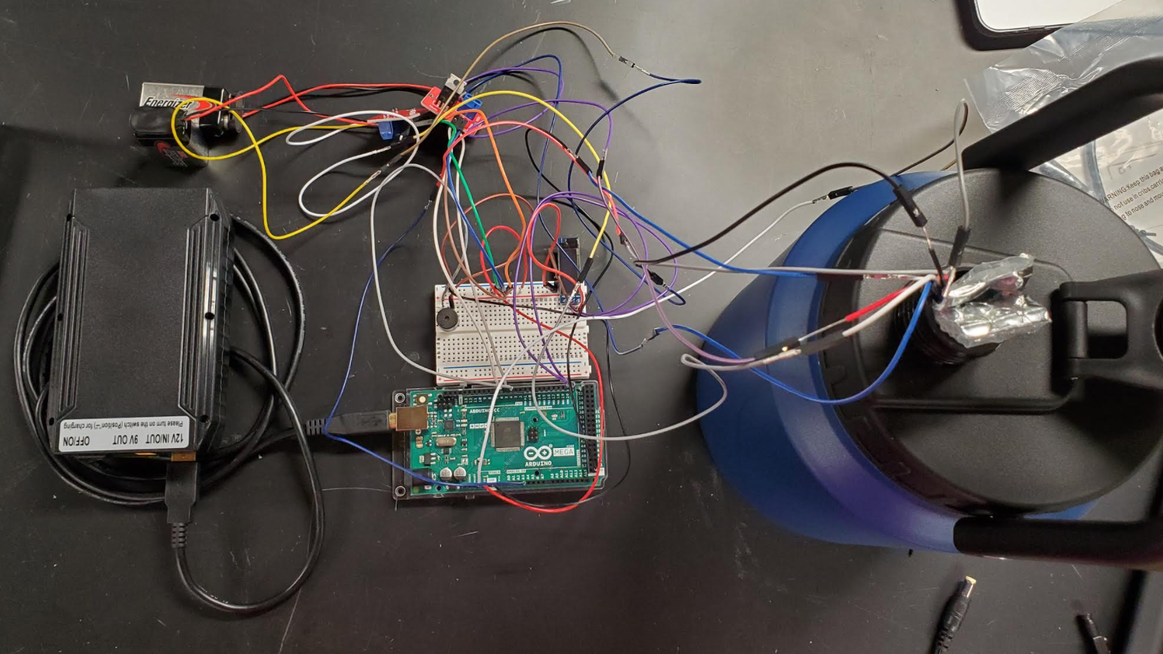
Medium-Fidelity Prototype: Control System and Thermos

Slide 14
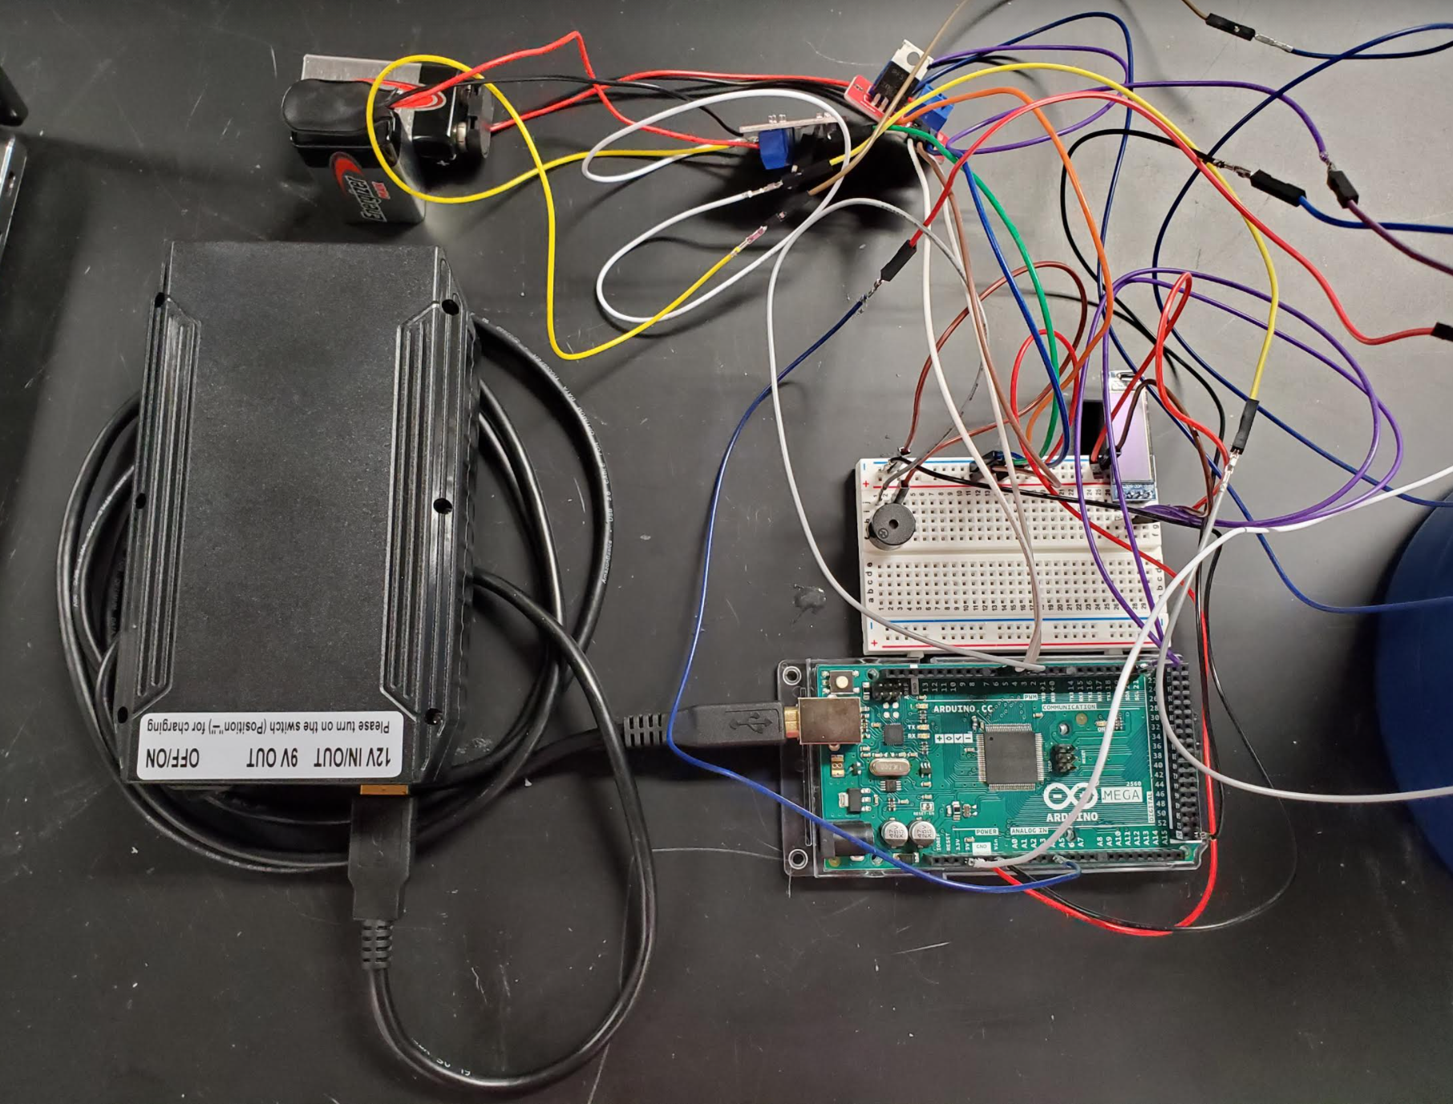
Medium-Fidelity Prototype: Control System
Voltage Booster
OLED Temperature Display
Alarm System
12V Battery
Arduino Mega
Control System Breakdown
Notes:
fix labeling
explain failure -> changing the design

Slide 15
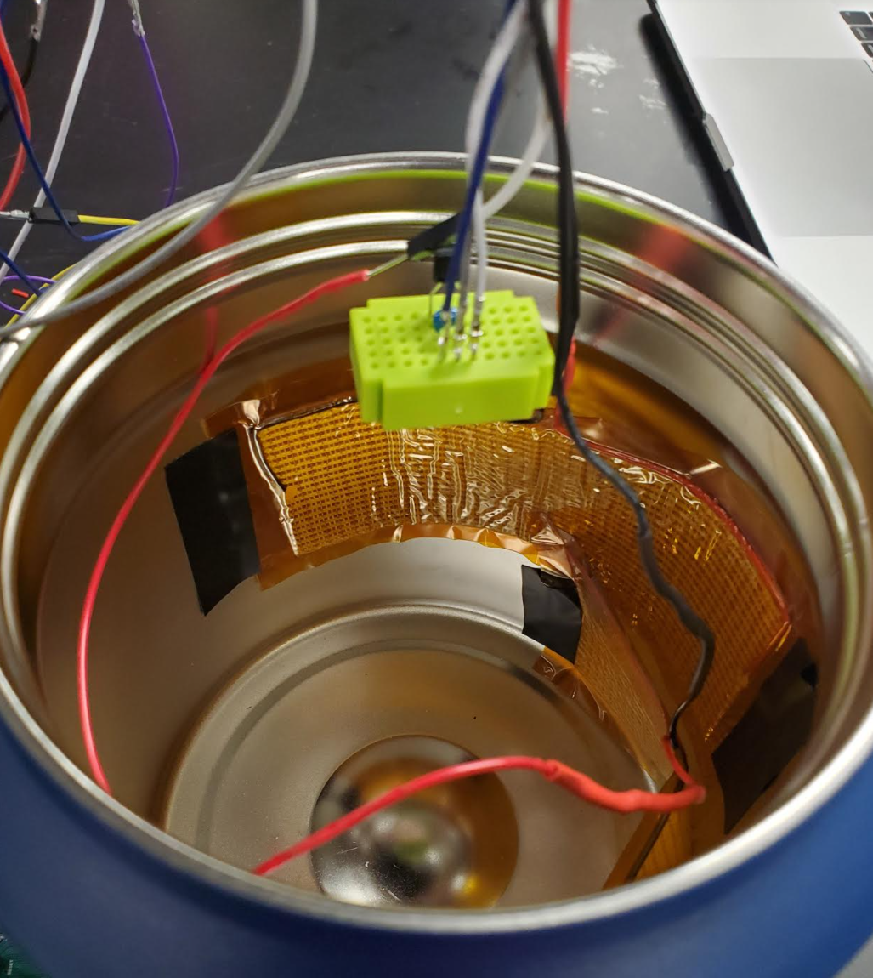
Medium-Fidelity Prototype: Thermos
Observations:
9V Batteries are not sustainable
Need bigger thermos
Temperature Sensor
Heating Pads
Needs work:
How all the components will be organized inside of the thermos
Interior of Thermos

Slide 16
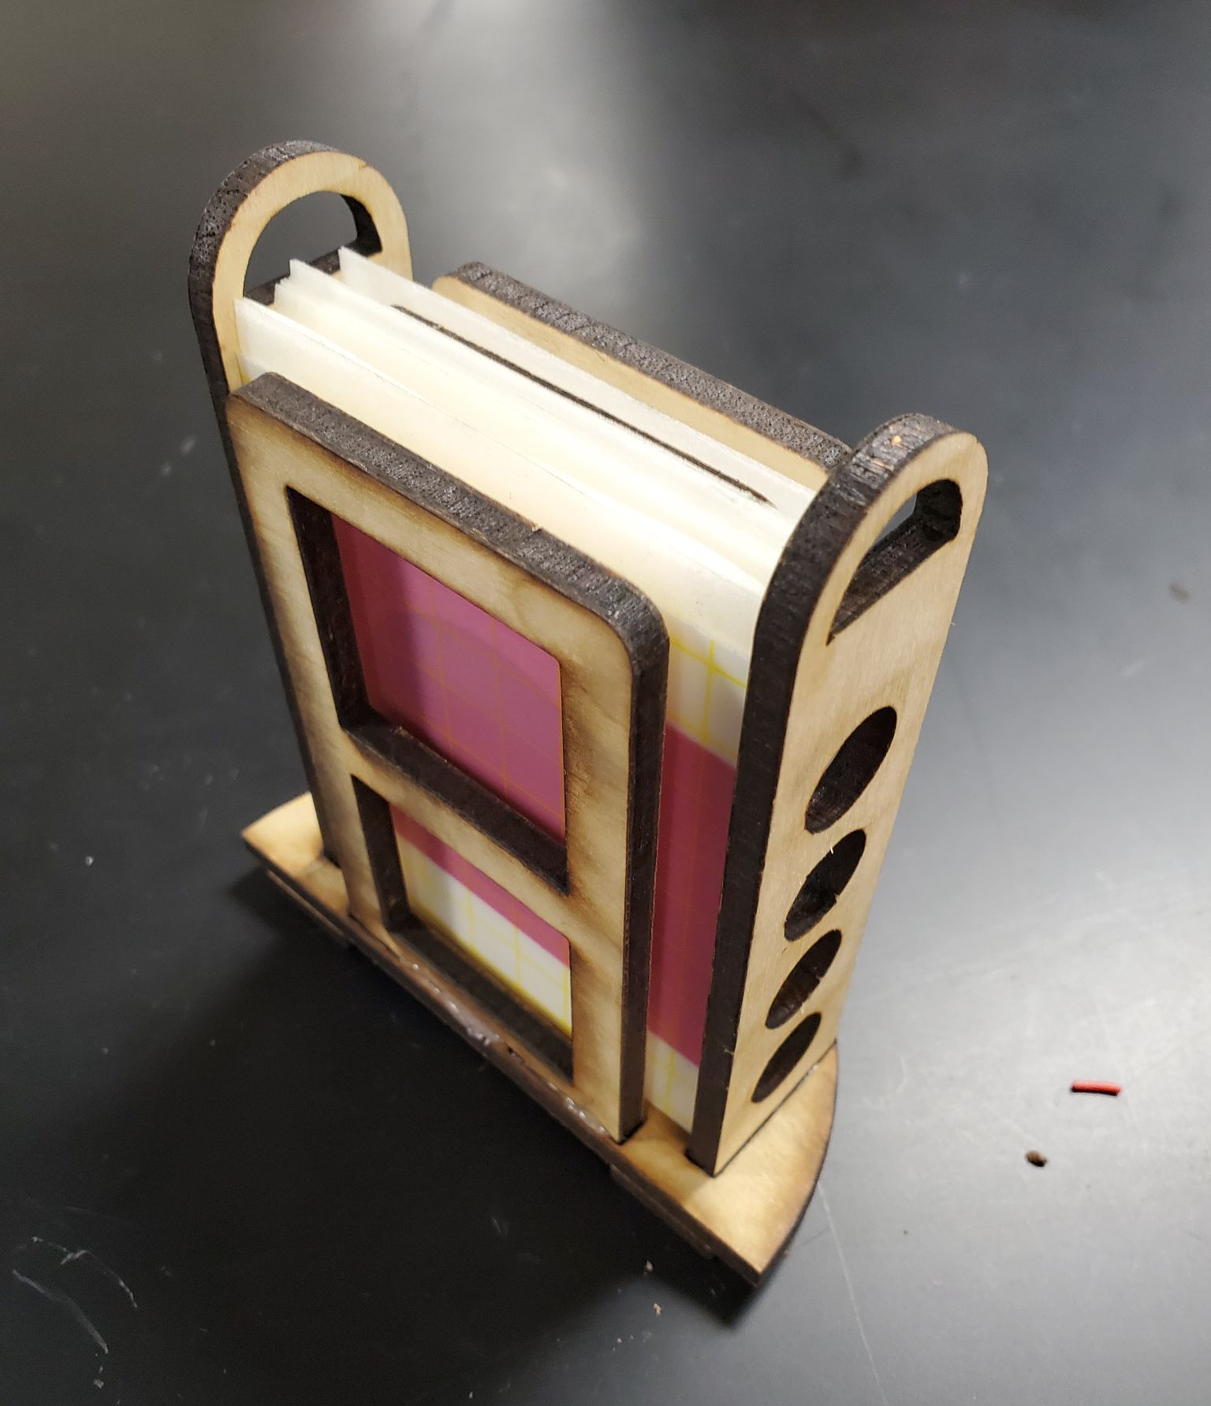
Medium-Fidelity Prototype: Petrifilm Shelf
Observations:
Might be too large to fit with the other components
Petrifilms
Holes for
Air Circulation
Needs work:
How all the components will be organized inside of the thermos
Concept Shelf for Petrifilms
Notes:
*mention that it petrifilms are inserted in vertical orientation and that we can fit 2 stacks of 10
* optional: may want to mention that base of this shelf is designed fit with bump in the middle of thermos

Slide 17
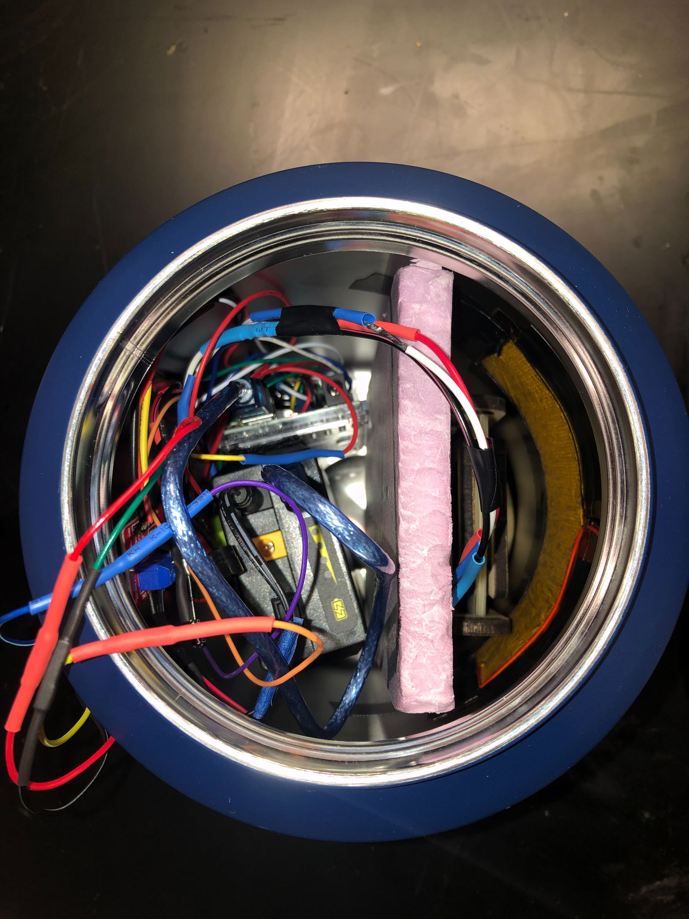
High-Fidelity Prototype
OLED Screen
Reflective Insulation
Heating System & Petrifilms
Control System
Final Portable Incubator
Overhead View of Incubator

Slide 18
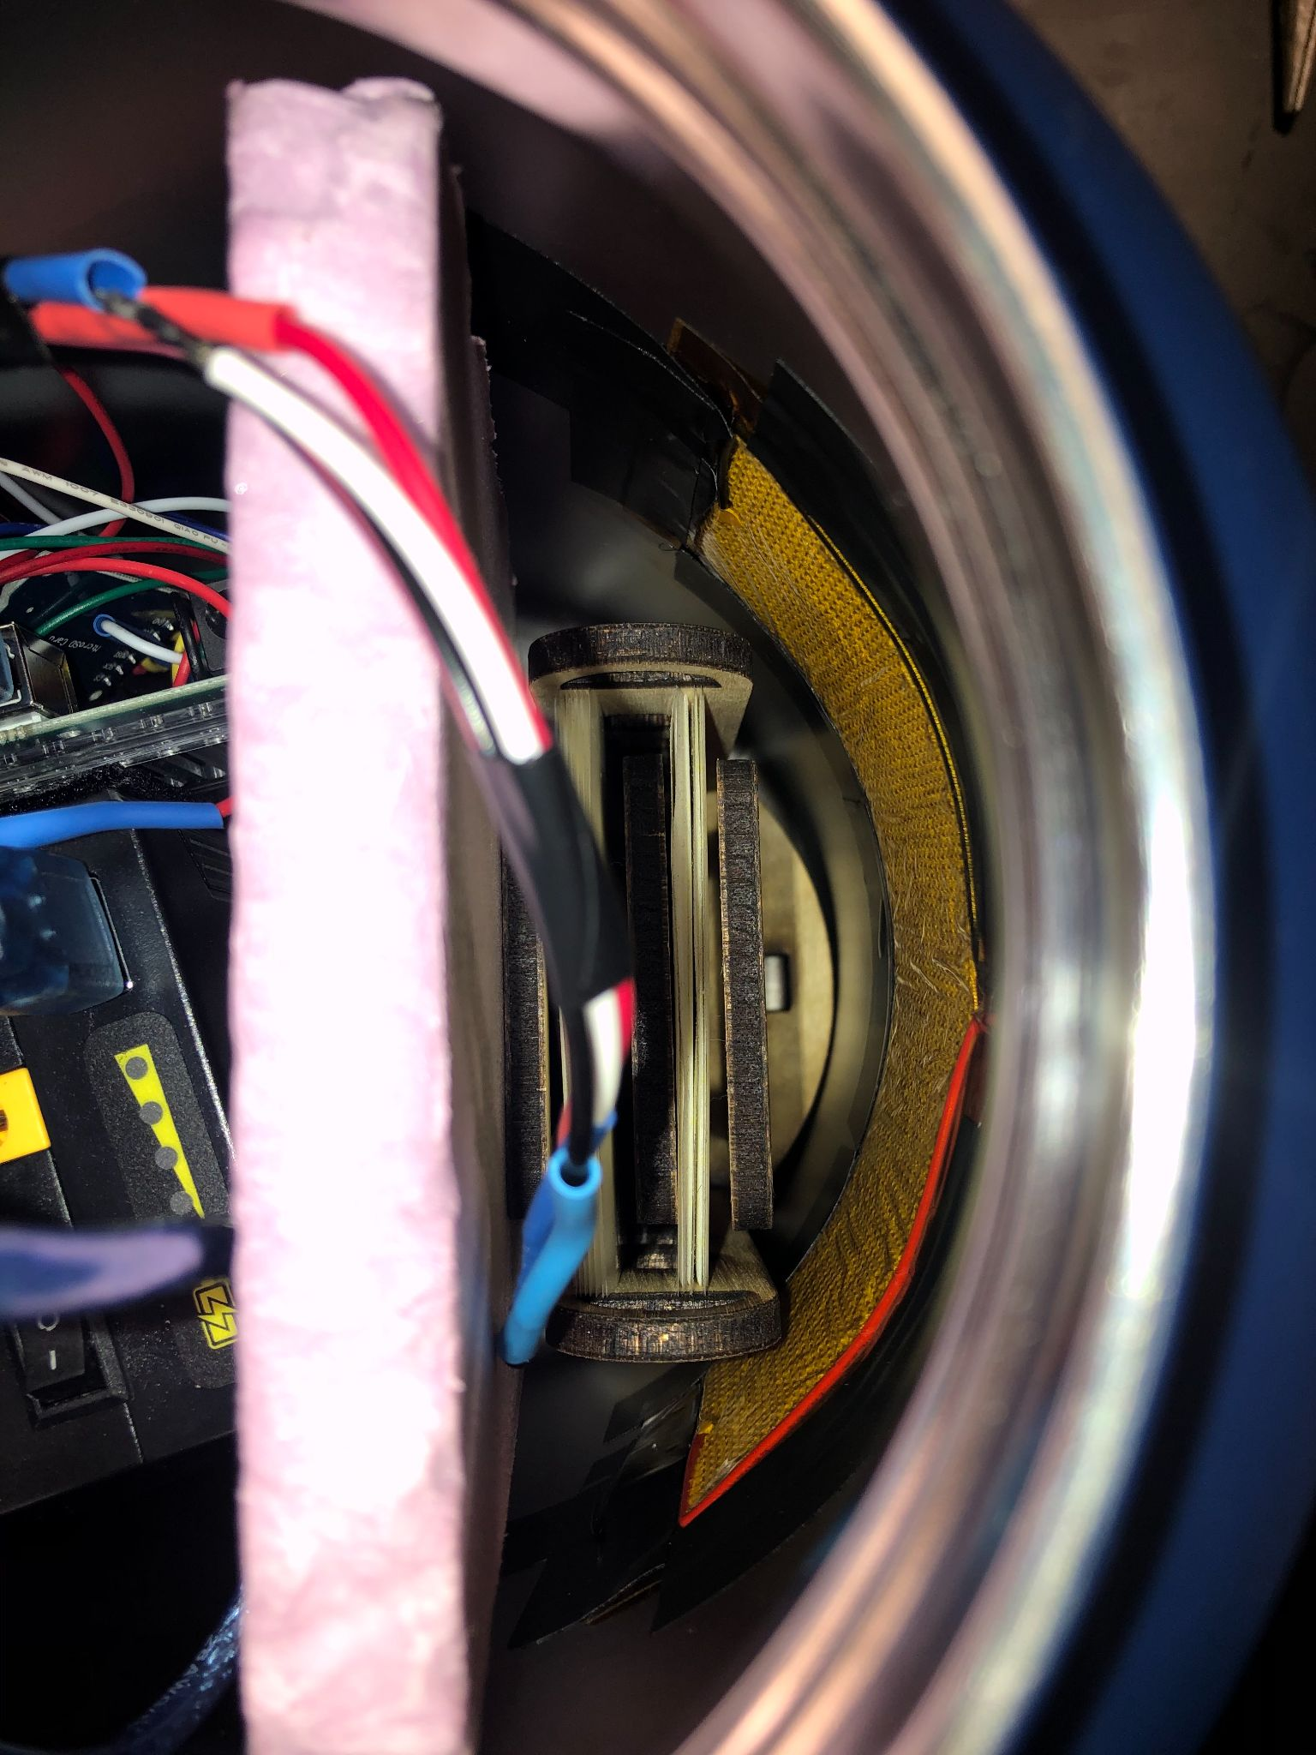
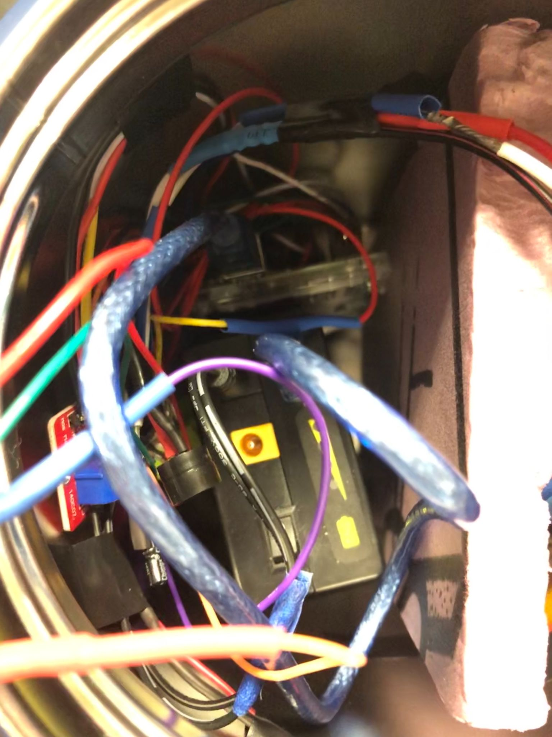
High Fidelity Prototype Interior
Arduino Mega
Heating Pad
Petrifilm Shelf
Temperature Sensor
Battery
Incubation Compartment
Electronics Compartment
Notes:
break down final design into critical design components & have bullet points on each of the side with the critical design components
be more structured on the way we introduce each component & directly explain what it does/why it is relevant
clarify that i have made justifiable decision
!! organization !!
add numbers - allowed us to keep it powered for x hours etc etc.

Slide 19
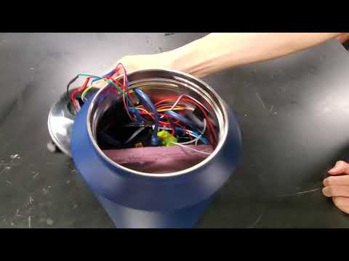
Notes:
SINDHUJA END
https://youtu.be/XZvEMkBjWKY

Slide 20
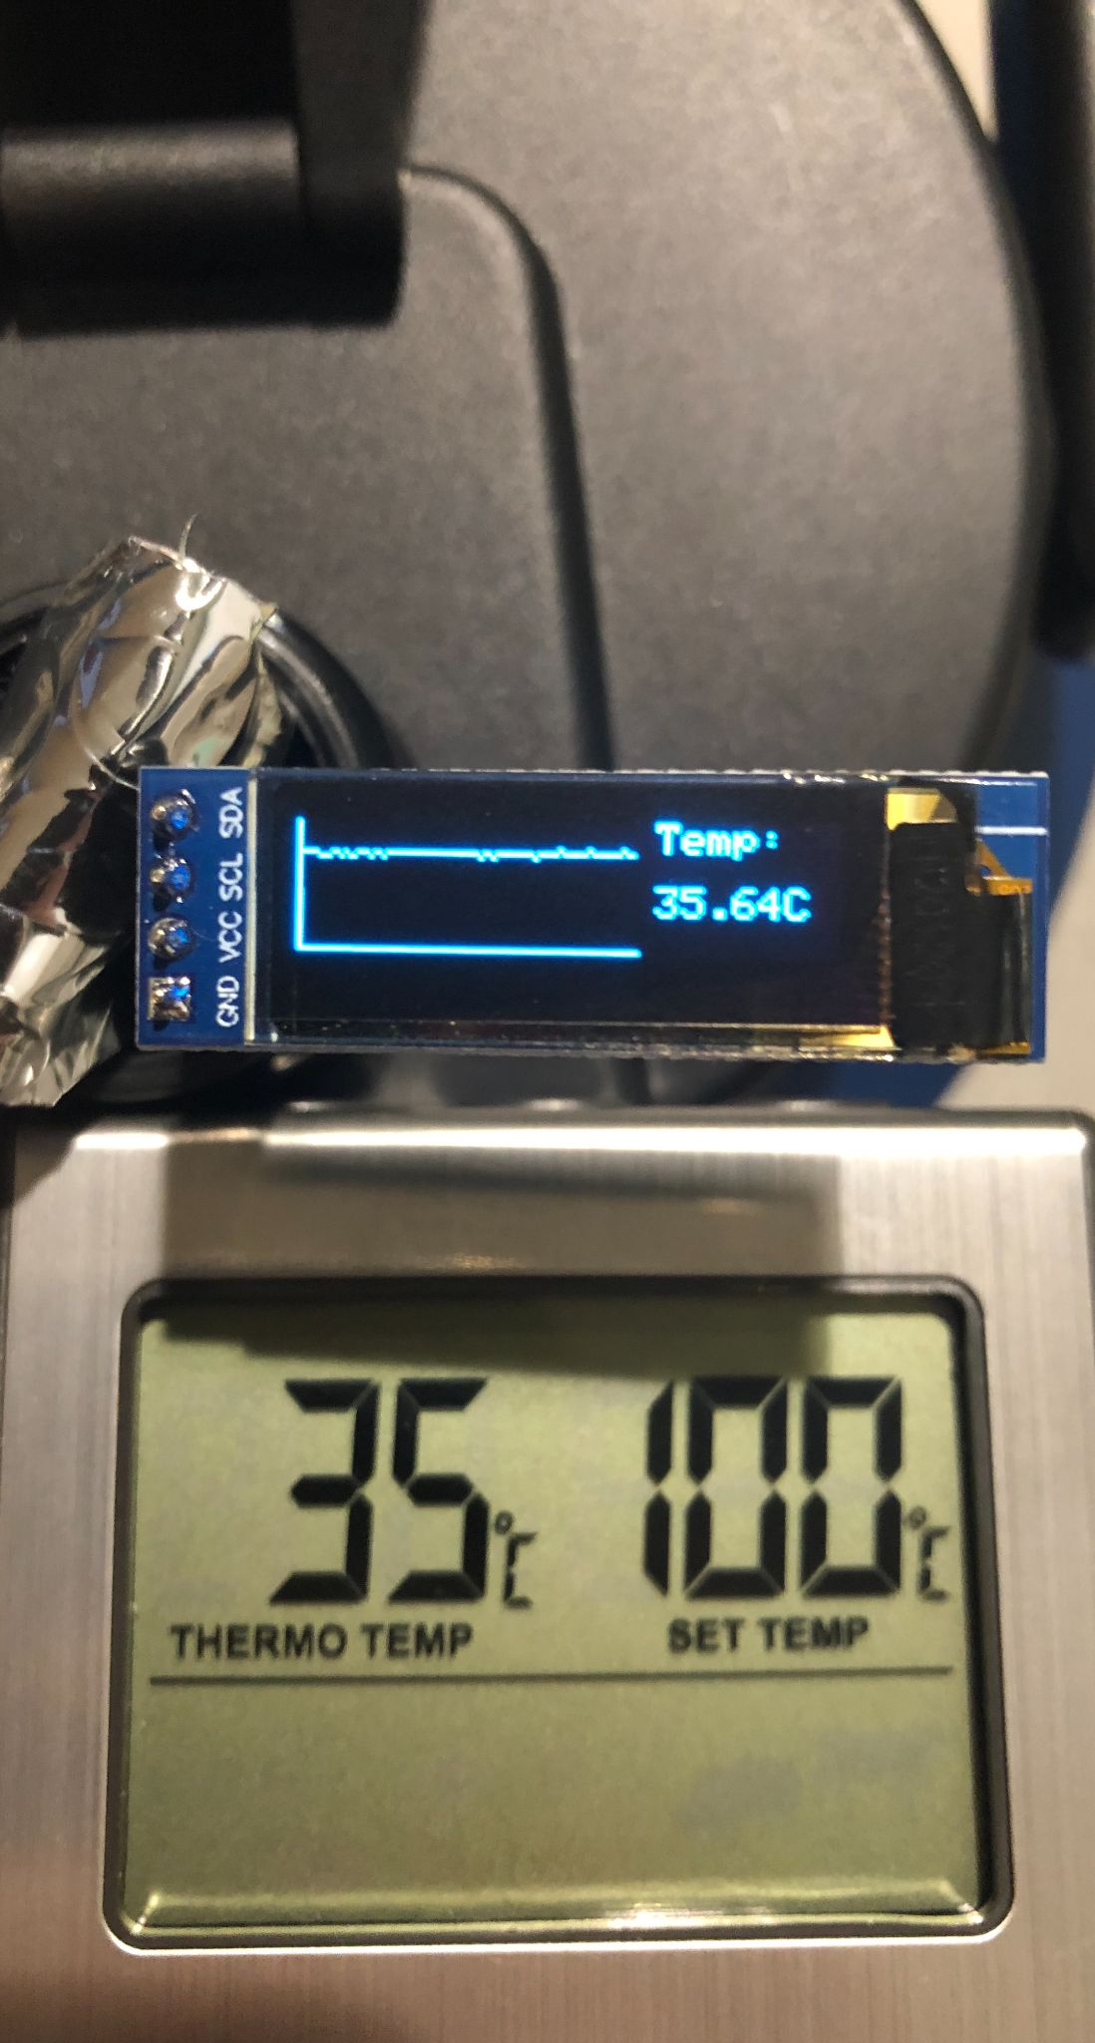
Accuracy of Temperature Readings
Goals:
Thermometer reading is within ± 1 °C of incubator LM35 reading
Results:
Successful
Temperature of Incubator
External thermometer
Accuracy Comparison
Notes:
***mention that temperature sensor is in heating chamber, while external thermometer is not, thus we can expect small variation in temperature reading
* tested on 5 different occasions
MICHAEL START

Slide 21
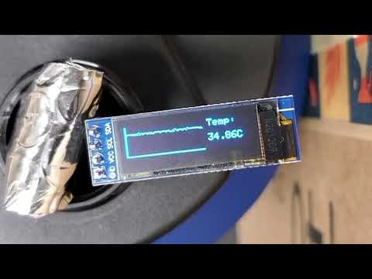
Incubator Maintains Desired Temperature
Goals:
Maintain temperature range: 34°C - 36°C
Results:
Successful
Temperature maintained between 34.01°C and 35.99°C during 20 minute time frame
Notes:
Testing
MICHAEL BEGIN
add “what happened” as the results (keep “successful”; draw attention to it)
Youtube link to video: https://youtu.be/u7282VahEhw

Slide 22
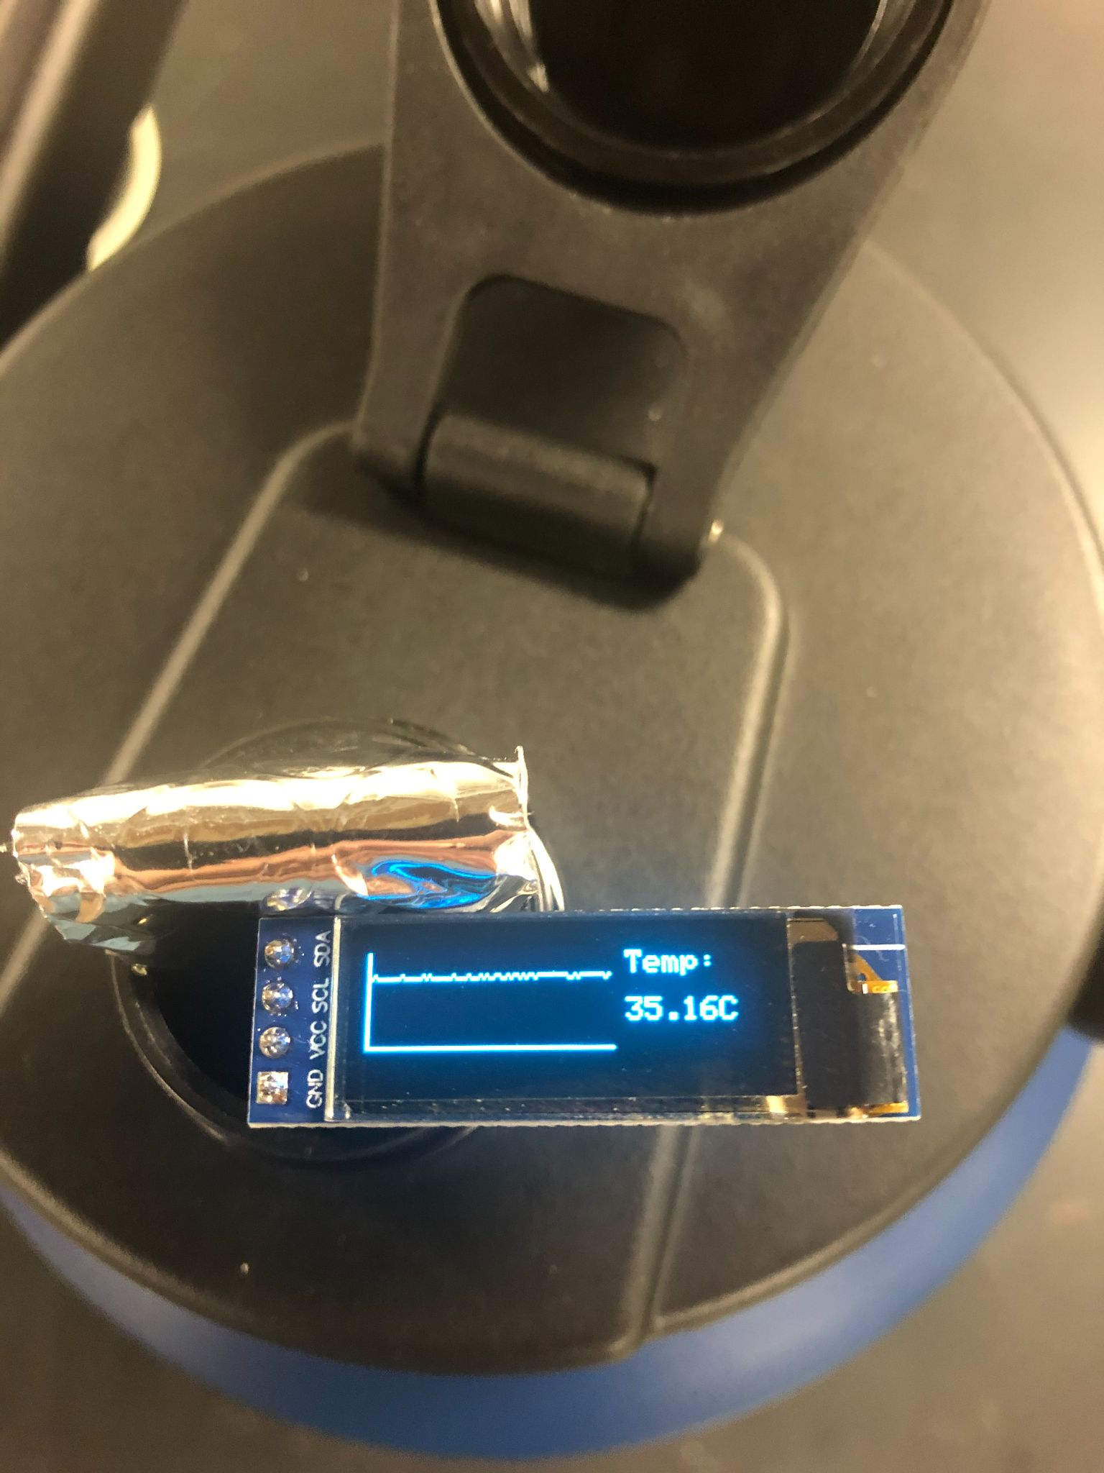
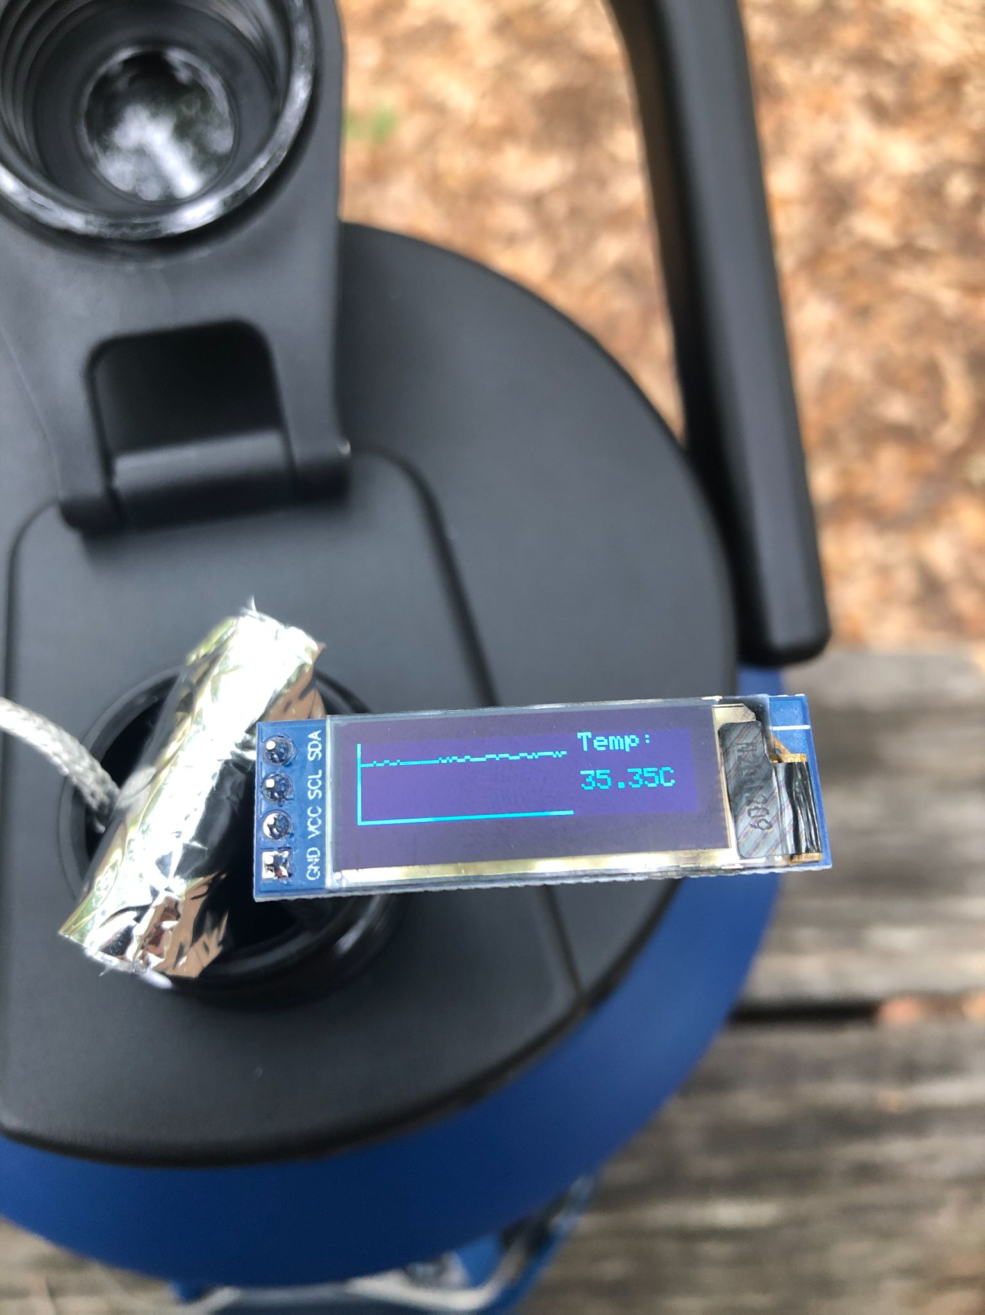
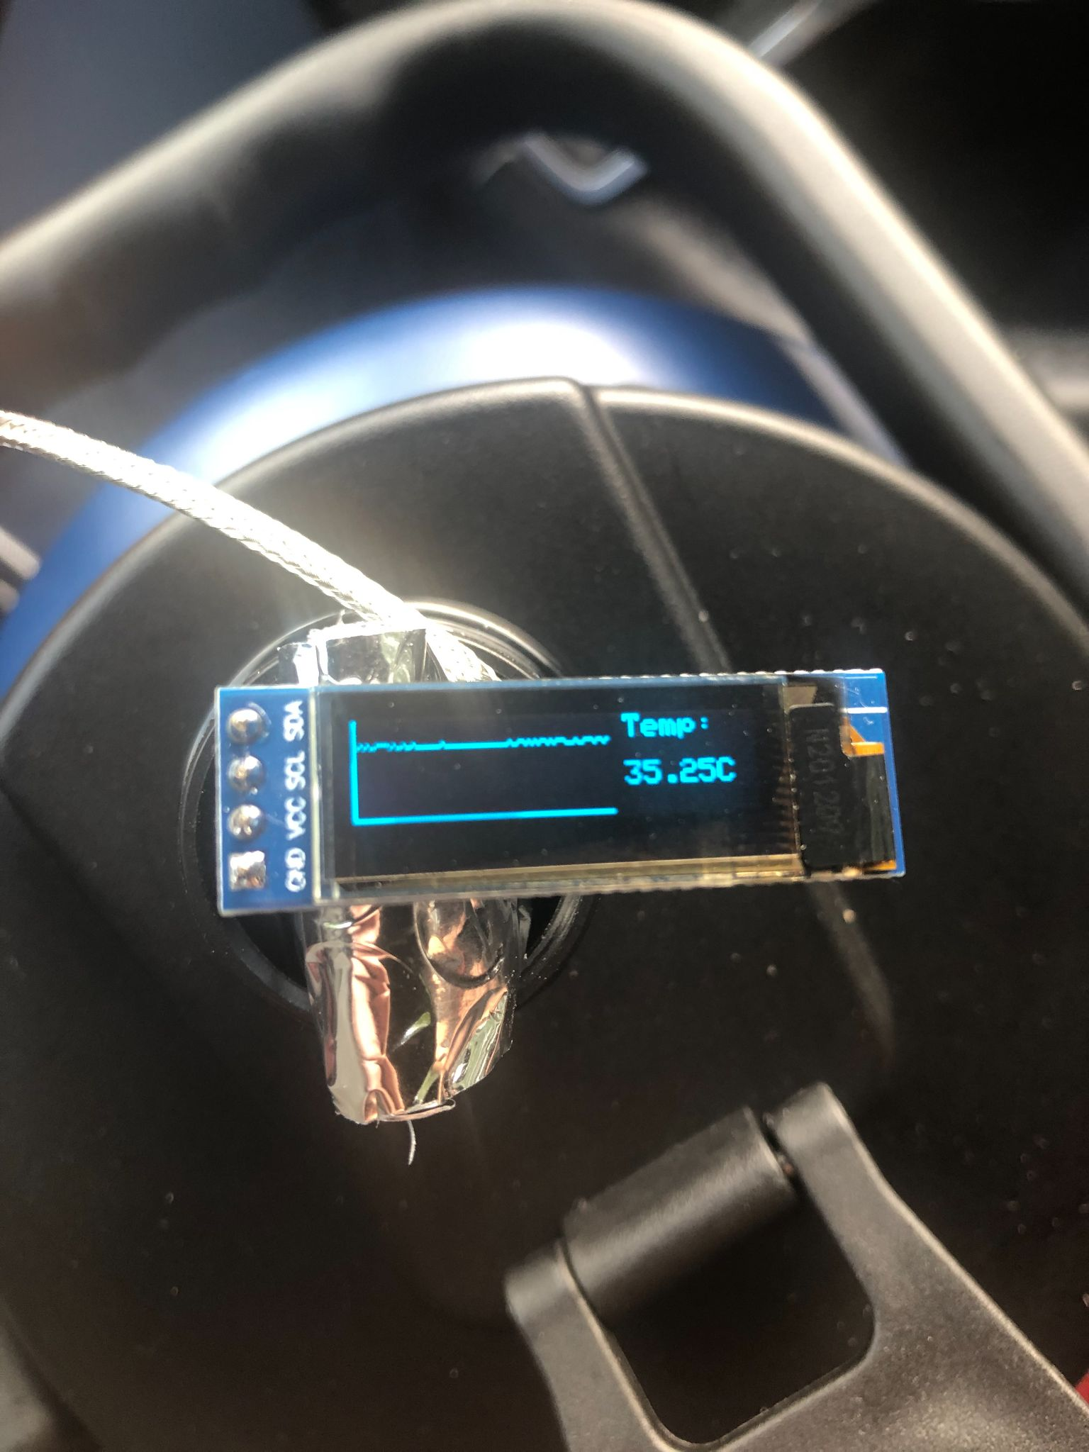
Field Test: Battery Duration and Temperature Maintenance
Time Elapsed: 10 minutes
Location: OEDK
Temp Reading: 35.16 °C
Surrounding Temp: 23 °C
Time Elapsed: 30 hours
Location: RMC Courtyard
Temp Reading: 35.35 °C
Surrounding Temp: 26 °C
Time Elapsed: 46 hours
Location: Car Ride to Campus
Temp Reading: 35.25 °C
Surrounding Temp: 24 °C
Notes:
Mention that we still will be conducting this test moving forward
be strategic about how we share testing
simulated carry it around
message what “testing for 29 hours is”
By the tine we present, system will have run for approximately 48 hours
Photos:
t = time elapsed after starting the system
Left Photo:
t = 10 minutes
Location: OEDK
Temp reading: 35.16 °C
Surrounding temperature: 23 °C
Middle Photo:
t = 30 hours
Location: Outside at a picnic table
Temp Reading: 35.35 °C
Surrounding temperature: 26 °C
Right Photo:
t = 46 hours
Location: In the car on the way to school
Temp Reading: 35.25 °C
Surrounding temperature: 24 °C

Slide 23
Design Constraint Fulfillment
Design Constraint | Target value
Temperature Fluctuation | Fluctuation between 34°C and 36°C for a 48 hour cycle
Safety | Full external waterproofing. No maintenance of electrical components needed for safety.
Notes:
Gray out the title boxes
Try to come up with numbers for safety

Slide 24
Design Constraint Fulfillment
Design Constraint | Target value
Temperature Fluctuation | Fluctuation between 34 °C and 36 °C for a 48 hour cycle
Safety | Full external waterproofing. No maintenance of electrical components needed for safety.
Notes:
Gray out the title boxes
Try to come up with numbers for safety

Slide 25
Design Objective Fulfillment
Design Objective | Target Value
Cost | < $300
Size | < (31cm x 34cm x 22cm)
 | Mass < 10 kg
Ease of Fabrication | 100% of parts can be purchased online or at a local store.
 | Any user can operate with user manuals and pre-recorded videos ≥ 3 on user defined scale
Durability | Operate for ≥ 20 field trips without maintenance. IPX6+ waterproof ability.
Battery Duration | Should operate for ≥ 24 hours after one charge.

Slide 26
Design Objective Fulfillment
Design Objective | Target Value
Cost | < $300
Size | < (31cm x 34cm x 22cm)
 | Mass < 10 kg
Ease of Fabrication | 100% of parts can be purchased online or at a local store.
 | Any user can operate with user manuals and pre-recorded videos ≥ 3 on user defined scale
Durability | Operate for ≥ 20 field trips without maintenance. IPX6+ waterproof ability.
Battery Duration | Should operate for ≥ 24 hours after one charge.
Notes:
durability -> add that we are gonna do a drop test

Slide 27
Final Prototype: Evaluation
Successes
Extremely portable
Long battery life
Affordable
*Minimal temp fluctuations
Limitations
Messy wires
Data logging is not functional
Notes:
decrease white space
title

Slide 28
Future Work
Drilling hole for OLED screen
Test ease of use and ease of fabrication using User Defined Scale
Test durability via drop tests
Implement user adjustable temperature
Replace wires with PCB
Notes:
TIMELINE format
*may want to add that we want to fix data logging
Medium fidelity - electronics should be working and testing data logging (programming)
Future work:
better cable management
fix data logging
testing ease of use & ease of fabrciation
get rid of breadboard

Slide 29
Low-Cost, Portable Incubator
Problem:
Water sanitation crisis
Need a portable way to assess bacteria in water
Solution:
A portable, thermos-based incubator
Impact:
Benefits residents of low-resource areas, field researchers
Final Portable Incubator
Notes:
change title & add description to pimage
needs to be more in depth
problem -> how our solution solved the problem -> impact
Extra

Slide 30
Acknowledgements
Professors:
Dr. Deirdre Hunter
Ms. Christina Rincon
Clients:
Dr. Chris Ferguson
Dr. Robert Read
Design Mentor:
Scott Lin
Writing Mentor:
Caterina Grasso Goebel
Faculty Mentor:
Dr. Ashley Taylor

